Slide 1

Twitionary
We Believe
Human conversation is precious data, it shouldn't be wasted
AI-Crowd-Sourcing Platform

Slide 2
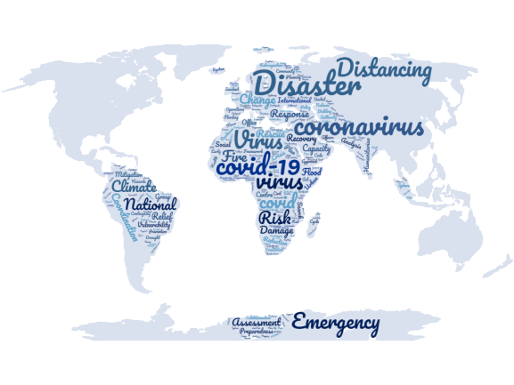

Mushtaq Ahmad
CO-PI
Mobilise Pakistan
We Are Challenging
The Traditional Flow Of
Irfan Syed
SOFTWARE ENGINEER
Mobilise Pakistan
Monitoring Information
Danish Mujahid
RESEARCH ASSISTANT
Mobilse Pakistan

Slide 3
Twittionary
Artificial intelligence-powered crowdsourcing platform to collect data from different resources based on provided keywords, Twitionary analyze collected data and perform sentiment analysis
Features
Addition/deletion of keywords for data collection
Scrape data from 500+ national/international sites,
Scrape more than 400,000 ( four hundred thousands) record per day
Scape English/Urdu news
Archived record since February 2020
Scrape 150,000 tweets per day
Perform sentiment analysis on every record
Statistically/Graphically view of performed analysis
Source of Data Collection
National/international News sites
Blogs sits
Twitter
©Mobilise, PAKISTAN

Slide 4
How it Works
Based on provided data dictionary (user can update dictionary) twitionary Scrape Data from different national/international news, blog sites and twitter
it stored the scraped data in Database
Based on scrape data Twitionary ML module perform sentiment analysis, the platform is hosted on Google cloud server
http://34.68.136.134/blog/
©Mobilise, PAKISTAN

Slide 5











Architecture
Sentiment analysis
Semantic & Perspective analysis
Data Categorization
ML & Deep Learning Modules
Social Media
Sentiment, Semantic Analysis NLP
Data Warehouse
News, Blogs
Filtration
News Archiving
Trending News
Personal Dashboard
All news in one place
Web & Mobile App for General User
Super Admin

Slide 6
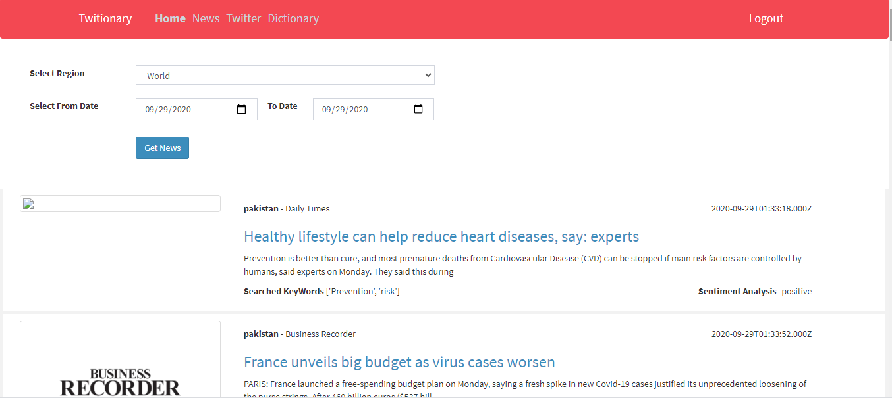
Snapshot
©Mobilise, PAKISTAN

Slide 7
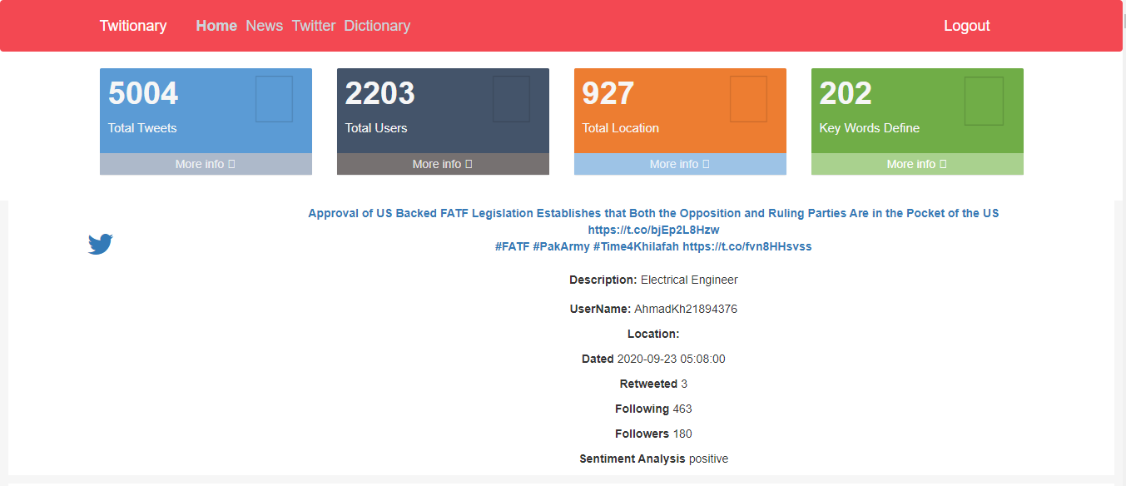
Snapshot
©Mobilise, PAKISTAN

Slide 8
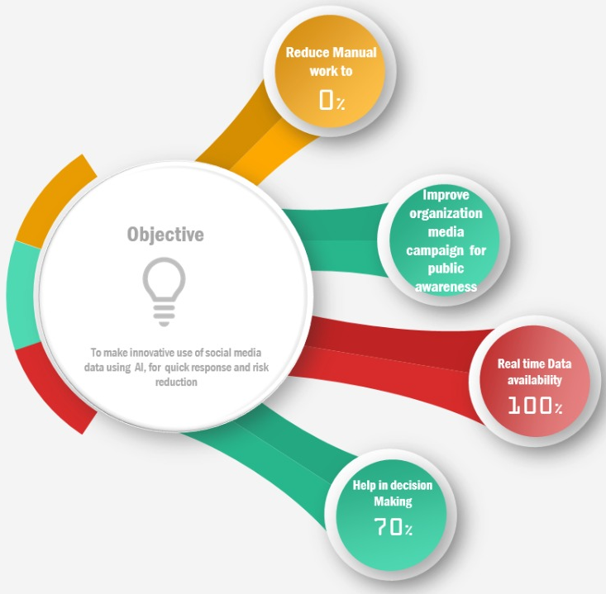
Objective
Reduce manual work
Improve organization media campaign for public awareness
Real-time data availability
help in decision making
10/11
©Mobilise, PAKISTAN

Slide 9
Application
Disaster Management Authorities can do a quick scan of Disaster-related real-time data during disaster situations.
Can help DMA in Early Warning System for those areas where functional EWS doesn't exist and communities highlight their Disaster-Related data on social media.
Retrieve disaster-related data and can initiate action on it.
Besides, when the send post about their DRR related actions, they can see and analyze the public, media response of their policy/decision.
Normally incidents are posted on social media but go unheard Twittionary trace those incidents and bring it to authority notice.
Similarly, organizations can track any false news, propaganda is rolling against them in social media, or can respond to myths, etc.
©Mobilise, PAKISTAN

Slide 10
THANK YOU
Team Mobilise-Pakistan
We will be happy to answer any questions

